Slide 1
State and District Academic Standards Professional Development
Marybelle Aguilar
EAD 523: Developing Professional Capacity
Grand Canyon University
Dr. Roberts
May 1st, 2024

Slide 2

Learning Objectives
Teachers will be able to create lessons with engaging activities.
Teachers will understand and learn how to develop engaging and effective instruction plans.
Teachers will be able to verbalize and assess the classroom resources and the purpose of them.
Objectives

Slide 3
Agenda (1 Hour)
5 min. – Ice Breaker/Make positive snowballs
5 min. – Learning Goals Overview (display timer to model time management)
15 min. – Lessons with engaging activities
Kagan strategies What Are Kagan Strategies? (weareteachers.com)
Activity - Think, Pair, Share
15 min. – Learn to develop engaging and effective instruction plans
Read: It’s Possible to Develop Effective and Engaging Lesson Plans
Activity: Mini-Discussion-Group (ARCS Model)
15 min. – Assess classroom resources
Share: Physical resources (digital clock, attention getters, motivational cheers)
Share: Digital resources (routines and strategies)
Share: Data resources
Best Time Management Tools That Help Teachers Stay Organized | Resilient Educator
Gradual Release of Responsibility Model (In 4 Easy Steps) (helpfulprofessor.com)
Effective Strategies to Maximize Student Learning Time (thoughtco.com)
5 min. – Close , QR Code, and handouts

Slide 4
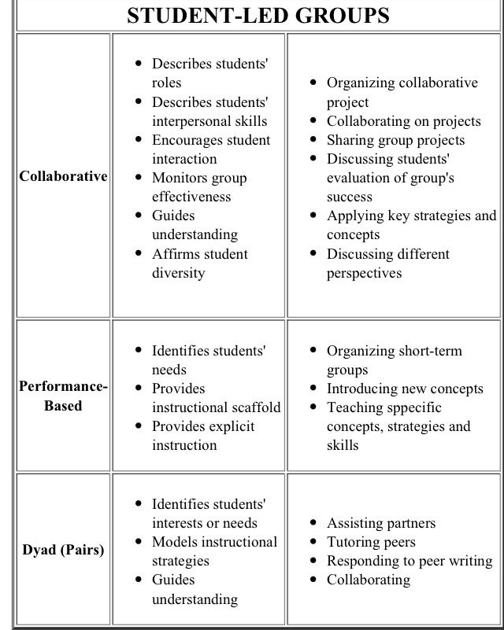
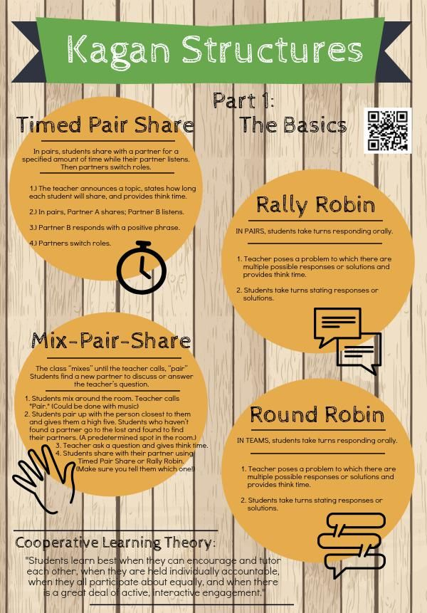
Introduction to Kagan Strategies
https://www.weareteachers.com/what-are-kagan-strategies/
s://youtu.be/D-yzgJtgVrg
Notes:
These are some engaging ideas that you can incorporate when writing out your lesson plans as well as implementing the state standards. Remember that the standards must be visualized in the classroom.

Slide 5
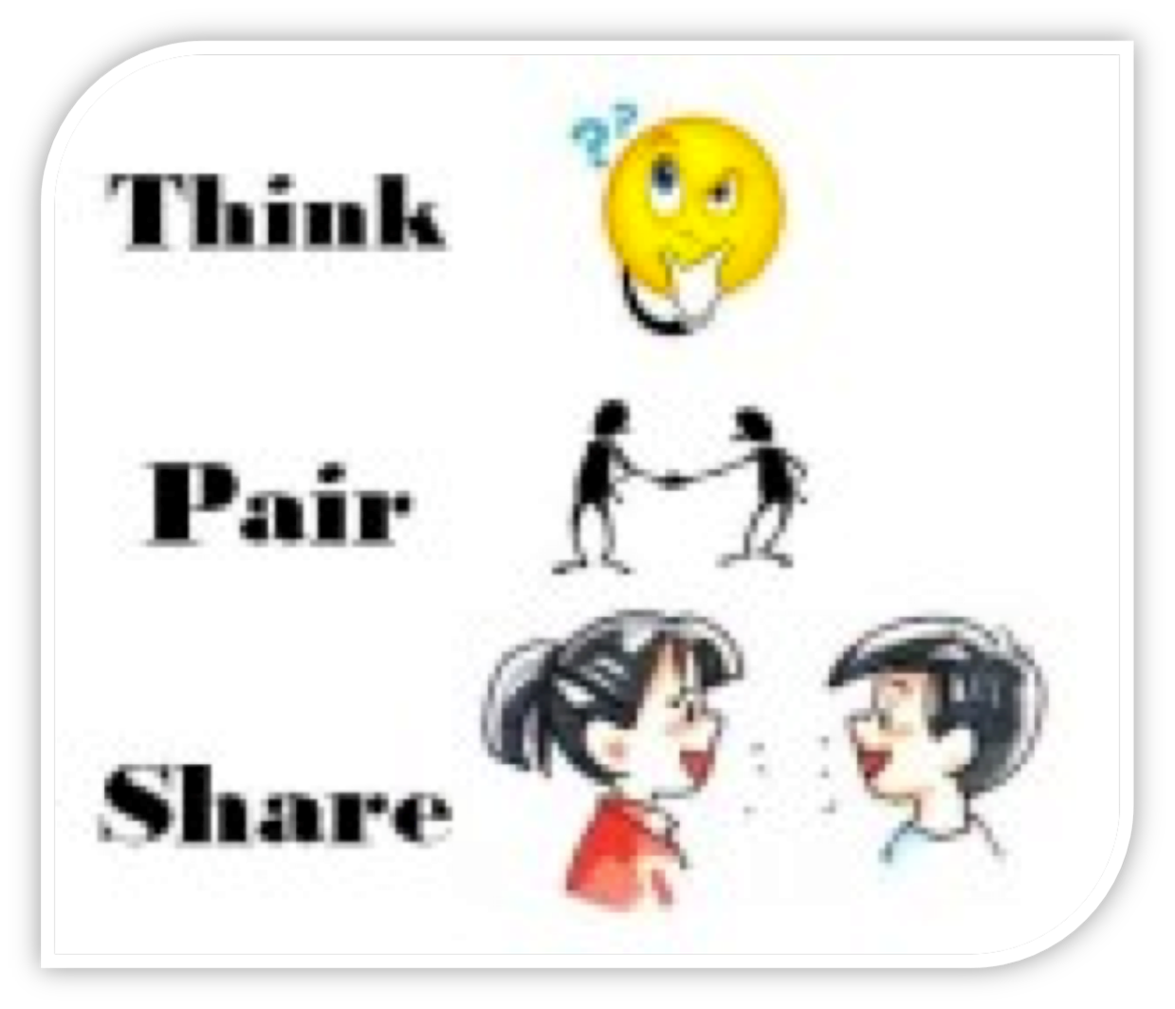
Activity:
Think,
Pair,
Share
Notes:
Display Timer for 5 minutes - https://youtu.be/MDk6V-B4Qhw?si=78sKqqgtpPJGF-4p

Slide 6

Read “It’s Possible to Develop Effective and Engaging Lesson Plans”
It's Possible to Develop Effective and Engaging Lesson Plans
Notes:
Remember: If you are not sure how to state the standard ask someone else to help, why reinvent the wheel!

Slide 7


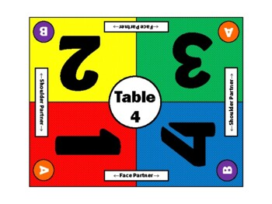
2. Activity
Choose a number from the table and find your group once the music starts playing.
What Share one take away from the reading.
How Write one take away from your group.

Slide 8


School Mission and Vision
To provide an engaging, challenging, and supportive learning environment. As well as to equip them with the skills to pursue their passions and develop their character to make a positive impact in society.

Slide 9
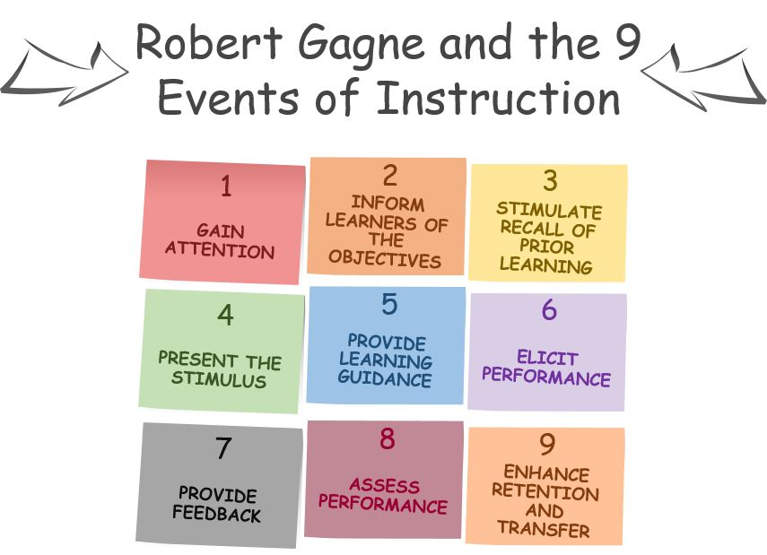
Gagne 9 Events of Instruction
Notes:
It’s flexible enough to be modified for a wide range of circumstances and simple enough to be readily incorporated into your existing lesson plans. The emphasis is firmly placed on the learner and teachers doing everything possible to ensure students capture, retain, and use the information taught to them. In this regard, it’s every teacher’s dream come true! (Kurt, 2021)

Slide 10
Closure
The Google form is emailed to you once receive it, please fill it out.
Review/Assess Classroom and data resources
Exit Ticket - Write two to three engaging strategies to use in your lesson plan.
Complete the Google Form
PDFeedback
Notes:
The teachers will fill out the PD feedback for online. They will also fill out in an index card their Exit Ticket

Slide 11
Accountability Plan
Teachers wrote plan to implement during PD
Admin. Will review lesson plans on Monday mornings and look for engaging activities and effective
Admin will collect data on walkthroughs and will be discussed (the following day)
Quotes for illustration purposes only

Slide 12

Celebrate!
Once a teacher has reached a goal CELEBRATE IT!
Notes:
Once a goal is met teachers are entered into a raffle for a gift card of their choice or free duty week. If it’s a class goal free extra recess, a chance for a pizza party and so on. We can even vote on some ideas.

Slide 13
References:
It’s Possible to Develop Effective and Enga... | ExploreLearning. (n.d.). Www.explorelearning.com. Retrieved April 25, 2024, from https://www.explorelearning.com/resources/insights/effective-engaging-lesson-plans#:~:text=How%20to%20Create%20Engaging%20%26%20Effective%20Lesson%20Plans
Kurt, S. (2021, January 1). Gagne’s Nine Events of Instruction. Educational Technology. https://educationaltechnology.net/gagnes-nine-events-of-instruction/
‌
Sanders, S. (2022, November 15). What Are Kagan Strategies? We Are Teachers. https://www.weareteachers.com/what-are-kagan-strategies/

